Slide 1
Online Hotel Reservation Management System
By
Md. Mehedi Hasan

Slide 2

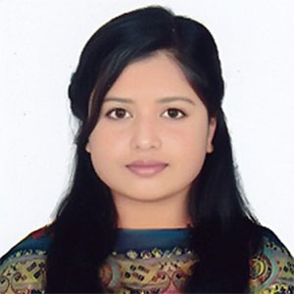
About us
Student
Supervisor
Md. Mehedi Hasan
Id# 21103032
Dept of cse, Iubat
Afsana akter lija
lecturer
Dept of cse, Iubat

Slide 3
Table of Content
Organization Overview
Project Overview
Requirement Engineering
System Planning
Project Cost Estimation
Analysis And Design
System Testing
Project Demonstration

Slide 4
ImpleVista
Independent And Trusted Advice
Custom Solutions Built On Nouveau Technologies
Superior Utilization Of Our Skilled Professionals

Slide 5
Project overview

Slide 6
Objectives
Streamline Hotel Operations: Automate Booking, Room Management, And Payment Processes For Efficient Hotel Management.
Enhance User Experience: Provide A User-friendly Interface For Guests To Explore Rooms, Services, And Make Seamless Bookings.
Facilitate Role-based Access: Enable Different Functionalities For Admins, Receptionists, And Users With Role-specific Features.
Real-time Data Management: Offer Real-time Updates On Room Availability, Bookings, And Payment Statuses.

Slide 7
Overview and Features
Web-based Platform: Automates Hotel Bookings, Payments, And Guest Management.
Role-based Access: Features Tailored For Users, Admins, And Receptionists.
Real-time Availability: Instantly Shows Room Availability And Booking Status.
User-friendly Interface: Easy Navigation For Searching Rooms And Booking.
Admin Dashboards: Provides Insights Into Hotel Performance And Occupancy Rates.

Slide 8
System Benefits
Efficiency: Automates Booking And Payment Processes, Reducing Manual Work.
Real-time Updates: Instantly Reflects Room Availability And Booking Statuses.
Improved User Experience: Easy Navigation And Seamless Booking Process For Guests.
Better Decision-making: Admin Dashboards Provide Data-driven Insights For Management.
Enhanced Communication: Direct Messaging Through Contact Forms For Better Guest Interaction.

Slide 9
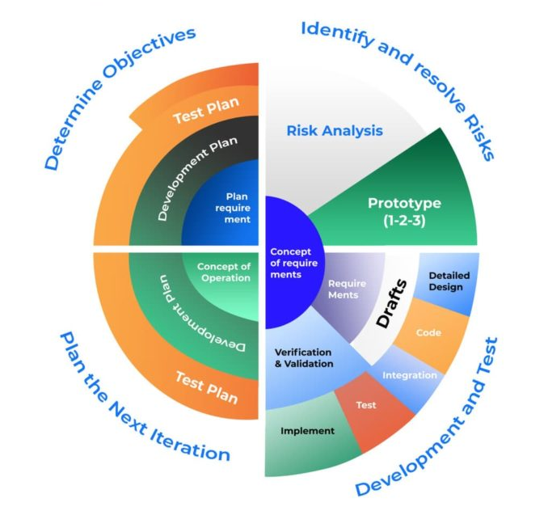
Process Model (Spiral)

Slide 10
Feasibility Study (Technical)
MERN Stack: Robust, Scalable, And Widely Adopted For Web Development.
Cloud Deployment: Can Be Hosted On Platforms Like Aws, Ensuring Reliability.
Database Scalability: Mongodb Supports High-volume Data Handling.
Role-based Security: Secure User Authentication And Access Control.
Responsive Design: Tailwind Css Ensures Compatibility Across Devices.

Slide 11
Feasibility Study (economical)
Low Development Cost: Open-source MERN Stack Minimizes Software Costs.
Reduced Operational Costs: Automates Processes, Lowering Staff Workload.
Scalability: Can Scale With Business Growth Without Major Reinvestment.
Minimal Maintenance: Modern Tech Stack Requires Less Ongoing Maintenance.
Increased Revenue: Improves Booking Efficiency, Leading To Higher Occupancy Rates.

Slide 12
Feasibility Study (Operational)
User-friendly: Easy For Guests And Staff To Navigate And Use.
Real-time Processing: Instant Room Booking And Payment Updates.
Customizable: Adaptable To Changing Hotel Needs And Business Rules.
Efficient Management: Simplifies Admin Tasks With Automated Workflows.
Customer Satisfaction: Enhances Guest Experience With Seamless Interaction.

Slide 13
Requirement Engineering
User Requirement
System Requirement
Functional Requirement
Non-functional Requirement

Slide 14
User Requirements
Account Management: Users Need To Register, Log In, And Manage Their Profiles.
Room Booking: Users Should Be Able To Search, Filter, And Book Rooms.
Payment Processing: Users Must Provide Payment Information For Bookings.
Booking History: Users Should Have Access To Their Past Booking Details.

Slide 15
System Requirements
Database: The System Should Store User, Room, Booking, And Payment Data.
Role-based Access: Different User Roles (Admin, Receptionist, User) With Specific Permissions.
Room Availability: System Should Handle Real-time Updates Of Room Availability.
Backup & Recovery: Ensure Regular Data Backup And Recovery Procedures.

Slide 16
Functional Requirement
User Authentication: Secure Login And Registration For Users And Admins.
Room Search & Filter: Users Must Be Able To Search And Filter Rooms Based On Criteria.
Booking Management: Admin Can Accept, Reject, Or Update Bookings.
Payment Processing: The System Should Support Multiple Payment Methods (E.G., Bkash, Nagad).

Slide 17
Non-Functional Requirement
Performance: Fast Loading Times For All Pages And Operations.
Scalability: The System Should Handle Growing User And Booking Data.
Security: Ensure Secure Data Transmission And Role-based Access Control.
Usability: The System Should Have An Intuitive, User-friendly Interface.

Slide 18
Analysis & Design

Slide 19
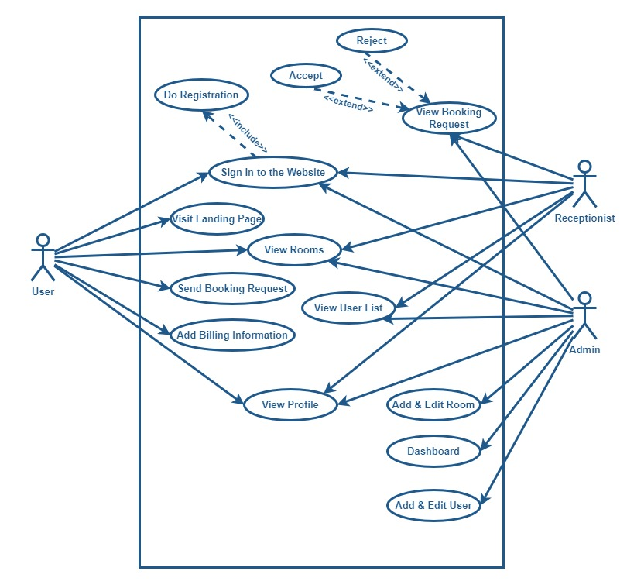
Use case diagram

Slide 20
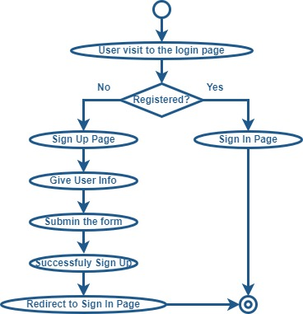
Activity Diagram (Authentication)

Slide 21
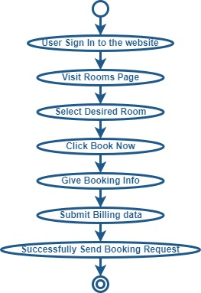
Activity Diagram (Booking Request)

Slide 22
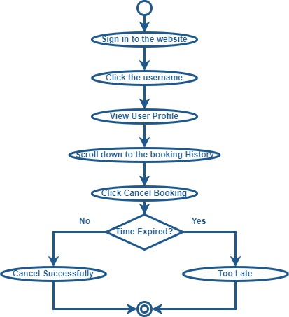
Activity Diagram (Cancel Booking Request)

Slide 23
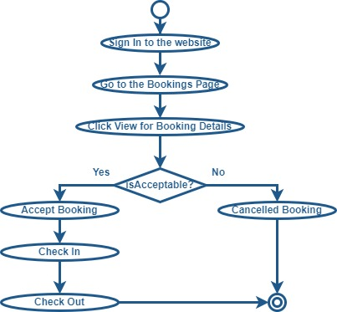
Activity Diagram (Manage Booking Request)

Slide 24
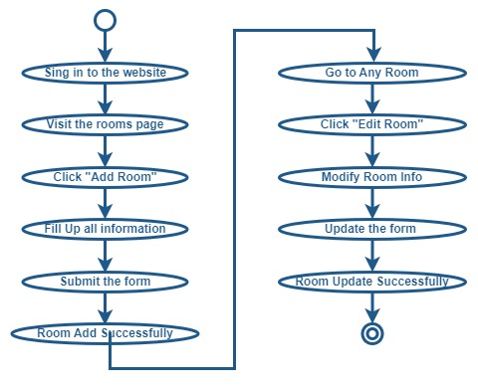
Activity Diagram (Manage Rooms)

Slide 25
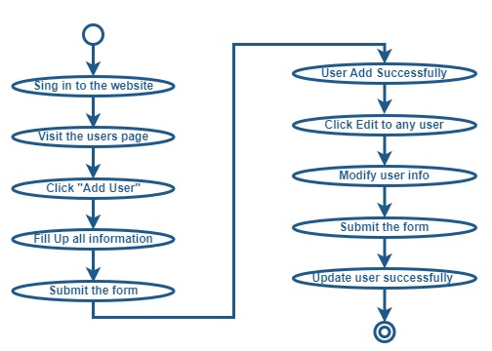
Activity Diagram (Manage Users)

Slide 26
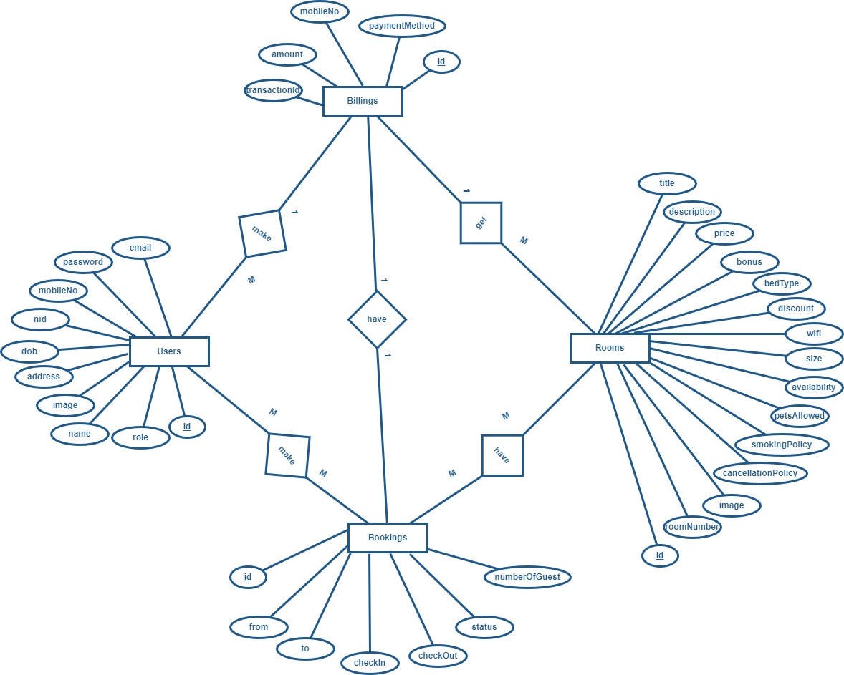
Entity relationship diagram

Slide 27
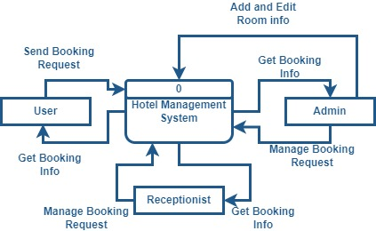
DFD (level 0)

Slide 28
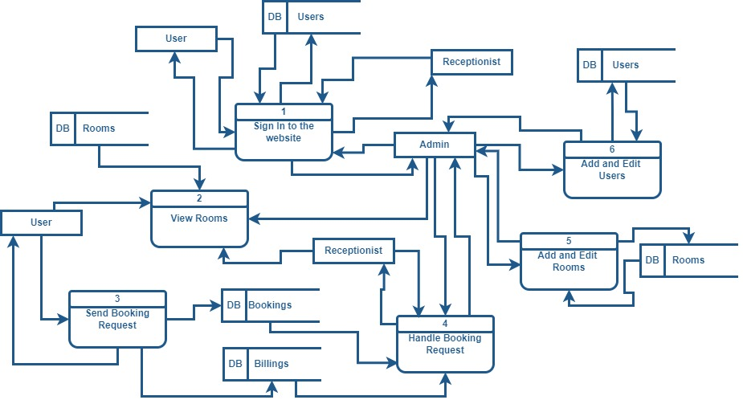
Dfd (Level 1)

Slide 29
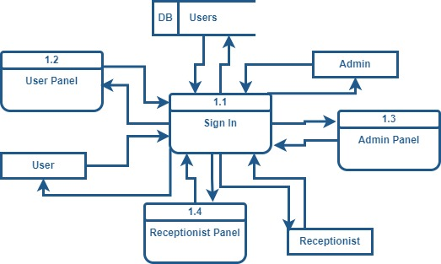
Dfd (level 2) Authentication

Slide 30
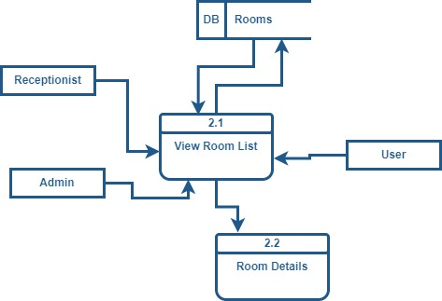
Dfd (level 2) room details

Slide 31
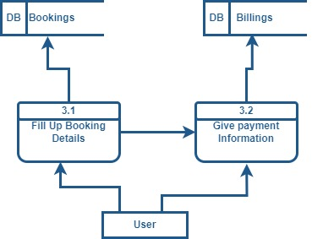
Dfd (level 2) booking request

Slide 32
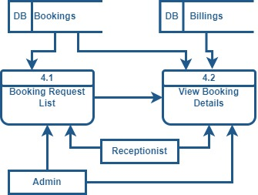
Dfd (level 2) booking details

Slide 33
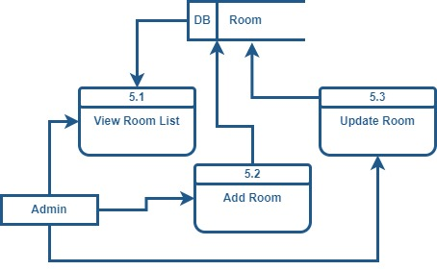
Dfd (level 2) Manage rooms

Slide 34
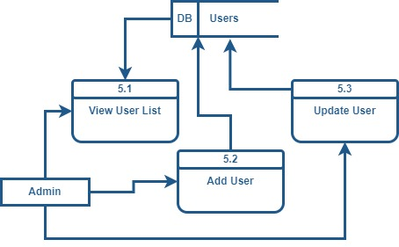
Dfd (level 2) Manage users

Slide 35
Estimation

Slide 36
Functional point estimation
Total ufp = 126
Afp = ufp*vaf = 126 * 1 = 126
Effort = 126/20 = 6.3 (Person Months)
Effort = 6.3*160 = 1008 (Person Hours)

Slide 37
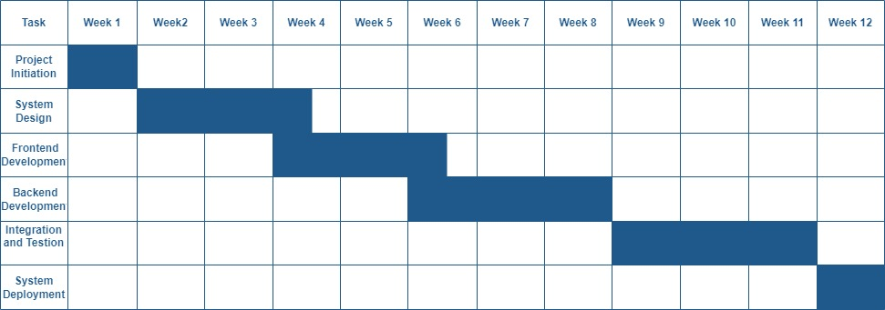
Project scheduling chart

Slide 38
Cost estimation (personal)
Task | Estimated Hours/Week | Weeks | Total Hours | Hourly Rate (BDT) | Total Cost (BDT)
Project Management | 5 | 12 | 60 | 2,000 | 120,000
Frontend Development | 20 | 8 | 160 | 2,000 | 320,000
Backend Development | 20 | 8 | 160 | 2,000 | 320,000
UI/UX Design | 10 | 4 | 40 | 2,000 | 80,000
Testing and Integration | 15 | 4 | 60 | 2,000 | 120,000
System Deployment | 10 | 1 | 10 | 2,000 | 20,000
Total Personnel Cost |  |  | 490 Hours |  | 980,000

Slide 39
Cost estimation (Software)
Item | Cost (BDT)
Design Tools (e.g., Adobe XD, Figma) | 15,000
IDEs and Development Tools (e.g., WebStorm, Visual Studio) | 20,000
Testing Tools (e.g., Postman) | 10,000
Version Control Hosting (e.g., GitHub) | 5,000
Total Software Cost | 50,000

Slide 40
Project demonstration

Slide 41
Limitations
AI Analytics: Introduce Advanced Analytics For Deeper Insights.
Mobile App: Develop A Mobile App For Better User Experience.
Multi-language Support: Add Support For More Languages.
Payment Payback Options: Couldn’t Payback Cancel Booking Automatically.

Slide 42
Future Works
Scalability Issues: May Struggle With High User Volume Without Optimization.
AI Integration: Implement AI Model To Increase The User Experience.
Automated Payback: Cancel Booking Request Send The Payment Back To The User.
Basic Analytics: Admin Dashboards Lack Advanced Insights.

Slide 43
Conclusion
Efficient Automation: Streamlines Bookings, Payments, And User Management.
User-friendly Design: Built With MERN Stack For A Smooth Guest And Staff Experience.
Potential For Growth: Can Be Improved With Advanced Analytics And Mobile App.
Future Adaptability: Enhancements Will Increase Value For Modern Hotels.

Slide 44

Any question?

Slide 45
Thank you everyone

